Slide 1
Making Decision
Chapter 03
Programming Fundamentals
ITP3915

Slide 2
Lesson Intended Learning Outcomes
Upon completion of this lesson, you should be able to:
Use basic conditional steps, if statement
Use of different comparison operators
Use two-way branch, else statement
Nested decision and chained condition
Know the indentation rules in Python

Slide 3
if statement
If a condition is true, then the body of the if statement executes
Condition must be Boolean type
Control always resumes after the if structure
The colon (:) at the end of the if statement is required
Single-entry / single-exit structure
Perform action only when condition is true
Indentation is very important
Remember: There is a colon here!
if condition :
statement 1
statement 2
following_statement
true
false

Slide 4
if statement
Condition
Program:
x = 5
if x < 10:
print ("Smaller")
if x > 20:
print ("Bigger")
print ("Finish")
x = 5
x < 10 ?
Yes (True)
No
(False)
print ("Smaller")
x > 20 ?
Yes (True)
No
(False)
print ("Bigger")
Output:
Smaller
Finish
print ("Finish")
Flowcharting the single-selection if structure

Slide 5
Relational / Comparison Operators
Relational operators are also called as Comparison operators
It is used to compare values
It either returns True or False according to condition
Relational operators look at variables but do not change the variables
Relational Operator | Meaning | Example | Result
< | Less than | 5 < 6 | True
<= | Less than or Equal to | 5 <= 6 | True
== | Equal to | 5 == 6 | False
>= | Greater than or Equal to | 5 >= 6 | False
> | Greater than | 5 > 6 | False
!= | Not equal | 5 != 6 | True

Slide 6
Example of Relational Operators
Program:
x = 5
if x == 5 :
print ("Equals 5")
if x > 4 :
print ("Greater than 4")
if x >= 5 :
print ("Greater than or Equal 5")
if x < 6 :
print ("Less than 6")
Output:
Equals 5
Greater than 4
Greater than or Equal 5
Less than 6

Slide 7
Logical Operators
Logical operators are typically used with Boolean (logical) values.
They allow a program to make a decision based on multiple condition
Logical Operator | Meaning | Example | Result
and | True if both the operands are True | 10 < 5 and 10 < 20 operand 1 operand2 | False
or | True if either the operands are True | 10 < 5 or 10 < 20 operand 1 operand2 | True
not | True if operands is False (complements the operand) | not (10 < 20) | False

Slide 8
if statement
When more than 1 statement should be executed when the condition is true, the statements must be maintained in the same indent, forming a block.
x = 5
Program:
x = 5
if x == 5 :
print ("Is 5")
print ("Still 5")
print ("Finish")
x == 5 ?
Yes
No
print ("Is 5")
print ("Still 5")
Output:
Is 5
Still 5
Finish
print ("Finish")

Slide 9
Two-way decisions
Perform action (statement1) only when condition is true
Perform different specified action (statement2) when condition is false
if condition :
statement 1
else :
statement 2
true
false

Slide 10
Two-way branch using else :
Program:
x = 4
if x > 2 :
print ("Bigger")
else :
print ("Smaller")
print ("Finish")
x = 4
No
x > 2 ?
Yes
print ("Not bigger")
print ("Bigger")
print ("Finish")
Flowcharting the single-selection if/else structure
Output:
Bigger
Finish

Slide 11
Nested if
The statement executed as a result of an if statement or else part could be another if statement
false
if condition 1 :
if condition 2 :
statement 1
else :
statement 2
else :
statement 3
false
cond1
true
cond2
true
statement 3
statement 2
statement 1

Slide 12
Nested Decision
Program:
x = 42
if x > 1 :
print ("More than one")
if x < 100 :
print ("Less than 100")
print ("Finish")
x = 42
x > 1 ?
Yes
No
print ("More than one")
x < 100 ?
Yes
No
print ("Less than 100")
Output:
More than one
Less than 100
Finish
print ("Finish")

Slide 13
Chained Conditionals
x = 10
Program:
x = 10
if x < 2 :
print ("Small")
elif x < 10 :
print ("Medium")
else :
print ("Large")
print ("Finish")
x < 2 ?
Yes
print ("Small")
No
x < 10 ?
Yes
print ("Medium")
No
print ("Large")
print ("Finish")
Output:
Large
Finish

Slide 14
Multi-way Puzzles
Which will never print?
if x < 2 :
print ("Below 2")
elif x >= 2 :
print ("Two or more")
else :
print ("Something else")
if x < 2 :
print ("Below 2")
elif x < 20 :
print ("Below 20")
elif x < 10 :
print ("Below 10")
else :
print ("Something else")

Slide 15
Indentation Rules

Slide 16
Indentation Rules
Increase indent after an if, while or for statement, or function definition. (after : )
Maintain indent to indicate the scope of the block (which lines are affected by the if, while, for, def)
Reduce indent to back to the level of the if, while, for, def statement to indicate the end of the block
Blank lines are ignored - they do not affect indentation
Comments on a line by themselves are ignored w.r.t. indentation

Slide 17
Warning: Turn Off Tabs
Most text editors can turn tabs into spaces - make sure to enable this feature
Eclipse with PyDev: Windows -> Preferences -> PyDev -> Editor -> Tabs
NotePad++: Settings -> Preferences -> Language Menu/Tab Settings
Python cares a lot about how far line is indented. If you mix tabs and spaces, you may get “indentation errors” even if everything looks fine

Slide 18
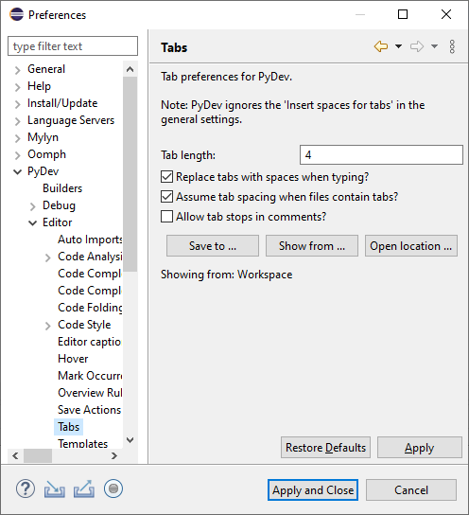
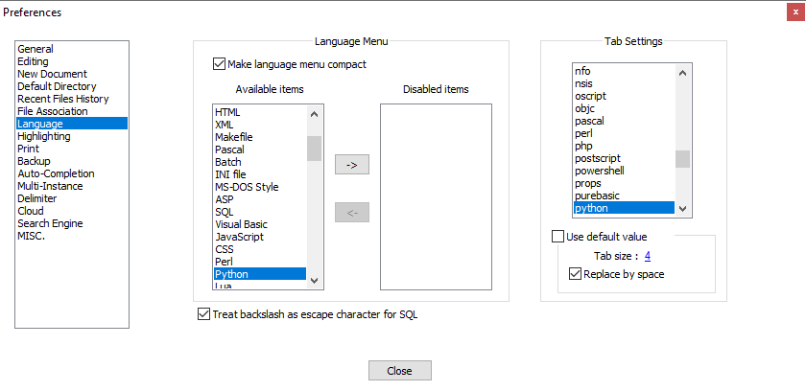
This will save you much unnecessary pain.
Eclipse Preferences
Notepad++ Preferences

Slide 19
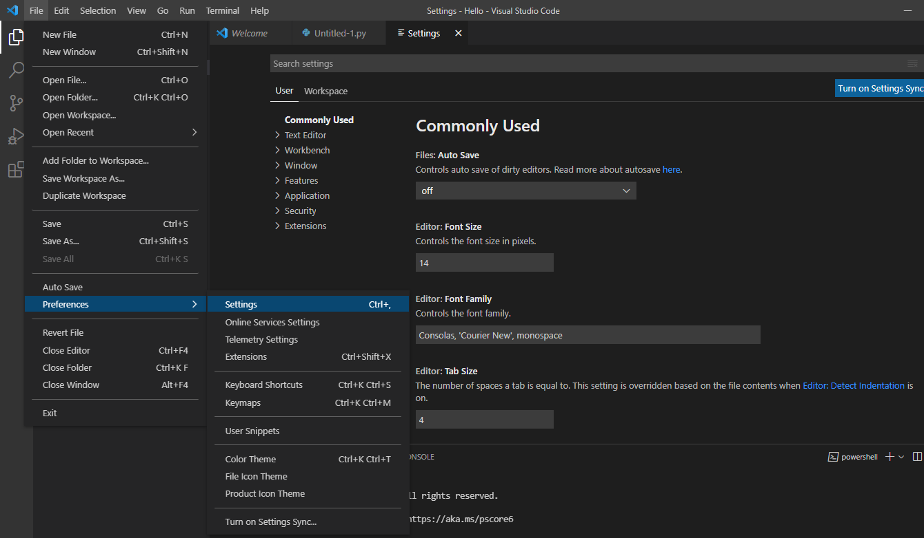
Warning: Turn Off Tabs
VS Code would guess your indentation options depending on the file you open
Preferences → Settings in Microsoft Visual Studio Code

Slide 20
Indentation Rules
Increase / maintain after if or for
Decrease to indicate end of block
Blank lines and comment lines ignored
x = 5
if x > 2 :
print ("Bigger than 2")
print ("Still bigger")
print ("Finish with 2")
for i in range ( 5 ) :
print ( i )
if i > 2:
print ("Bigger than 2")
print ("Finish with i", i)
x = 5
if x > 2:
# comments
print ("Bigger than 2")
# don’t matter
print ("Still bigger")
# but can confuse you
print ("Finish with 2")
# if you don’t line
# them up

Slide 21
End

